Slide 1


—
Administrative Law 2025
Week 7 Introduction to Grounds of Review
Dr Richard Taylor
Lecturer, School of Law

Slide 2
Week 7 Overview
How did we get here?
Grounds of Review
Recap ADJR – Grounds of Review
In this week’s lecture, we look at grounds of review & related issues
Errors of Fact vs Law
Acting Beyond Power
Necessary and Convenient Clauses
Subordinate Legislation
Delegation and Agency
Summary

Slide 3
How did we get here?
Week1
Week 2
Week 3
Week 4
Introduction to Admin Law
Statutory Interpretation &
Delegated Legislation
Mechanisms of Transparency & Accountability
Merits Review
Examines the origins and importance of Admin law and covers key concepts
Concerns rules of statutory interpretation and the legal status of delegated legislation
Mechanisms of accountability outside of more common judicial and merits review
Ombudsman=men/ Privacy
the power, legislation permitting, to have a full rehearing, fresh evidence, and ultimately, a determination
A1
Week 7
Week 6
Week 5
Grounds of Review
Limits to Judicial Review
Judicial Review
Introduces concepts of acting beynd
Ones authority and procedural rquiirements for delegation to be effective
Explores the need for standing,
persons aggrieved (ADJR Act)
and the AG’s fiat
Introduce judicial review via s 75(v) of the Constitution, the common law and through statute., exploring concepts of justiciability and jurisdictional error.
A2
A3
Week 8
Week 9
Week 10
Week 11
Week 12
Procedural Fairness
Grounds from Statute
Grounds from
General Law
Remedies
Revision
Provides a detailed examination of natural justice, procedural fairness, legitimate expectations, the hearing rule and the rule against bias
Explores areas where authority has been granted by statute but errors made in the decision making process
The ‘no evidence’ and
unreasonableness grounds
arising under general law
Finally, we consider the remedies
available such as prohibition, certiorari, mandamus, injunction, declaration and other remedies under the ADJR Act
Recap of the full course
Administrative Law –LAW1023

Slide 4



What are the grounds of review?
Common Law
The basis for arguing that the court should grant relief are the grounds for arguing that a decision is affected by a reviewable error
– “an error of law”
– “ a ground for review”
Common law grounds/constitutional grounds/statutory grounds contain substantial overlap
Constitution
Statute
Administrative Law –LAW1023

Slide 5

Grounds of review
‘Grounds of review’ so called because they encapsulate the ways in which decision makers might act without lawful authority (or contrary to the terms of their authority)
The Common Law grounds of review have now been essentially codified in the ADJR Act. Generally in parallel*.
*Note there are two ADJR Act grounds– ‘error of law’ and ‘no evidence’ –that are catchall provisions and are different from common law grounds
Administrative Law –LAW1023

Slide 6
Broad categories of grounds (not fixed)
Acting beyond power
Factual errors
Disregard of express procedural requirement
Improper delegation
Failure to take account on mandatory considerations
Failure to afford natural justice
Improper purpose
Fraud/Bad Faith
Fettering of discretion;
Failure to exercise discretion;
Unreasonableness;
Irrationality
No evidence;
Administrative Law –LAW1023

Slide 7

Statutory judicial review – ADJR Act (Recall)
Section 5(1) – Grounds:
Breach of rules of natural justice
Required procedures not observed
No jurisdiction (jurisdictional error)
Decision not authorised by the enactment
Improper exercise of power (see further s 5(2))
Error of law whether or not on the record
Fraud
No evidence (see further s 5(3))
j) Contrary to law
There is no (i)! This appears to have been a quirk in the drafting process – it wasn’t removed by an amendment – appears it simply never existed.
Administrative Law –LAW1023

Slide 8

Statutory judicial review – ADJR Act (Recall)
Section 5(2) – Improper exercise of power
Irrelevant consideration(s)
Failure to take into account relevant consideration(s)
Purpose other than statutory one
Bad faith
Exercise of personal discretionary power under direction of another
Failing to take into account merits of particular case
Wednesbury unreasonableness
Uncertain result
j) “Any other exercise of a power in a way that constitutes abuse of the power”
“For instance, on the planet Earth, man had always assumed that he was more intelligent than dolphins because he had achieved so much—the wheel, New York, wars and so on—whilst all the dolphins had ever done was muck about in the water having a good time. But conversely, the dolphins had always believed that they were far more intelligent than man—for precisely the same reasons.”
Administrative Law –LAW1023

Slide 9
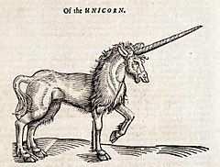
Statutory judicial review – ADJR Act
Section 5(3) – No Evidence
No evidence from which administrator can be reasonably satisfied that ‘particular matter was established’
Decision based on evidence of fact that did not exist
Administrative Law –LAW1023

Slide 10

Fact v Law Distinction
Administrative Law –LAW1023

Slide 11

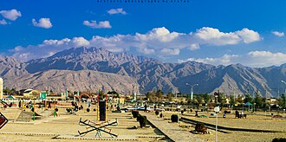

Errors of law v errors of fact
• Decision maker must make conclusions about law and facts
• In general error of fact is not an error of law
• However:
  If decision depends on existence of a particular fact then this equals a jurisdictional fact and may be reviewed
  If the acceptance of that fact is based on no evidence may be reviewed
  If the incorrect finding is irrational or unreasonable may be reviewed
  See Hedari v Minister for Immigration and Border Protection [2020] FCA 298
Quetta market bombing 2013: Source ABC
Administrative Law –LAW1023

Slide 12
Hedari v Minister for Immigration and Border Protection [2020] FCA 298
Mr Hedari granted a protection visa and citizenship
Wife and children applied for partner visas (but had used apparently fake documents)
Refused by Minister’s delegate (no compelling circumstances to justify the grant of the visa)
Family sought review in AAT. AAT supported decision of the Minister on grounds that Hedari could travel to Pakistan. This was incorrect - the Department of Foreign Affairs and Trade advice for the city of Quetta was ‘reconsider your need to travel’. However, for Balochistan (capital of Quetta) was ‘do not travel’.
Hedari sought judicial review.
Arguments accepted by the Federal Court that it was not possible to travel to Pakistan.
Quetta market bombing 2013: Source ABC
Administrative Law –LAW1023

Slide 13
Hedari v Minister for Immigration and Border Protection [2020] FCA 298
Finding that the area in question was only subject to a ‘reconsider your travel’ ( as apposed to no travel) was irrational and illogical
The finding was unreasonable
AAT has failed to perform its task appropriately
AAT failed to take account of relevant material - Jurisdictional Error
Quetta market bombing 2013: Source ABC
Administrative Law –LAW1023

Slide 14
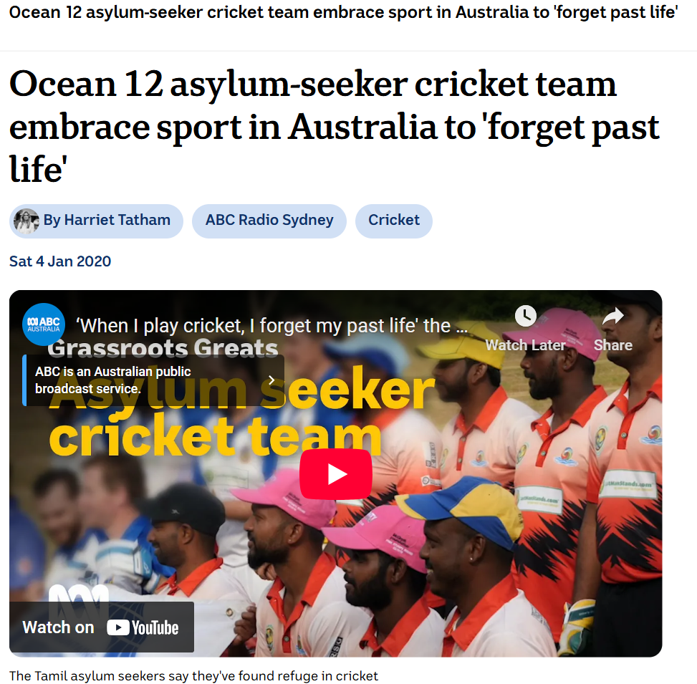
Multiple grounds – BAK18 v Minister for Home Affairs (2020) 274 FCR 268
Common law grounds (only one successful ground required)
BAK18 wife and children, Tamils, sought protection visas, for fear of persecution in Sri Lanka
Minister refused, reviewed by Immigration Assessment Authority (IAA), affirmed refusal.
Grounds
IAA had refused to consider new evidence (captaincy of a Tamil cricket team which suggested was Tamil) failed on ground of materiality;
Secretary failed to provide material to IAA re: mother and brother and the basis on which they had been granted protection visas (similar situation). Successful and this was a jurisdictional error; and not providing material was unreasonable. This argument was not considered.
Administrative Law –LAW1023

Slide 15

Acting beyond power (misconceiving the scope of the power)
ADJR Act
s5(1) (c) – that the person …did not have jurisdiction
s 5(1)(d) – ‘that the decision was not authorized by the enactment in pursuance of which it was purported to be made’
s5(1) j)-…..otherwise contrary to law
Administrative Law –LAW1023

Slide 16
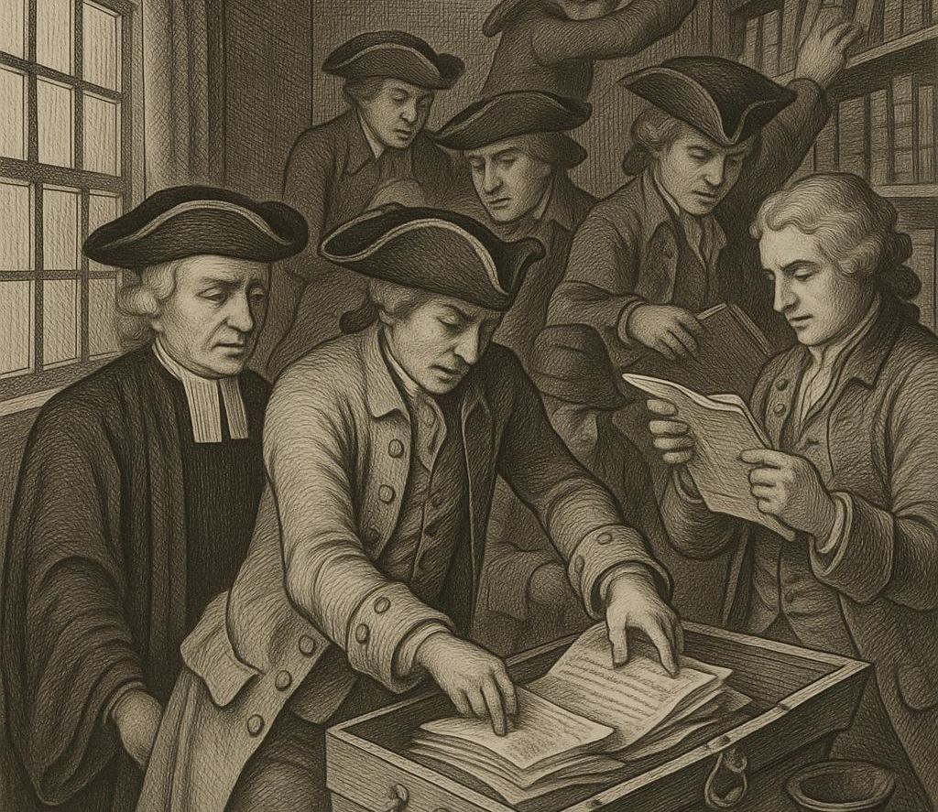

Acting beyond power (misconceiving the scope of the power)
The basic principle that all government action must be sourced in law applies to administrative acts as well as the making of delegated legislation. Both common law and ADJR Act ground, s 5(1)(d) – ‘that the decision was not authorised by the enactment in pursuance of which it was purported to be made’
Entick v Carrington (1765) 19 St Tr 1030 Secretary of State issued search warrant for seditious material against Mr Entick. Sued for trespass and won. All government action must be sourced in law; especially if it affects rights such as private property. Lord Camden CJ: rights preserved unless taken away ‘by some public law for the good of the whole’ in this case no such law existed.
A v Hayden (No 2) (1984) 156 CLR 532 ASIS officers not authorised to commit criminal offences, without express statutory exemption from prosecution. Crown in the past had ‘dispensing power’ but HCA said its danger had been recognised and it had been fully abolished by 1689 Bill of Rights.
Administrative Law –LAW1023

Slide 17
Acting beyond power (misconceiving the scope of the power)
Other examples of unauthorised acts:
ICAC v Cunneen (2015) 318 ALR 391 Cunneen’s purported advice to her son’s friend after a car accident (to fake chest pains) did not fall within the definition of corrupt conduct under the Act. Therefore, ICAC had no authority to investigate.
Foley v Padley (1984) 154 CLR 349 Rundle St Mall Act 1975 (SA) provided that council could make by-laws ‘regulating, controlling or prohibiting any activity in the Mall…in council’s opinion…likely to affect the use or enjoyment of the Mall’. By-law No 8 provided that ‘no person shall give out or distribute anything in the Mall…to bystanders or passers-by…without permission of the council’. SA leader of the Hare Krishnas challenged – HCA upheld. NB Brennan dissent and contrast with Re Gold Coast City By-Laws [1994] 1 Qd R
London City Council v Attorney-General [1902] AC 165 A statutory power to run ‘tramways’ did not authorize running a bus service
Vickers v Minister for Business & Consumer Affairs (1982) 43 ALR 389) A statutory power authorising customs agents to seize ‘goods, moveable property, or monies in the form of cash’ did not authorise seizure of money in a bank account
Administrative Law –LAW1023

Slide 18
Acting beyond power – the role of statutory interpretation
Statutory interpretation is important here (revise Topic 2)
Decision maker (and any reviewer) must always interpret and apply the statute on which the decision was based
Principles of statutory interpretation (recall ss15AA and 15AB Acts Interpretation Act 1901 (Cth))
Presumptions – recall eg principles of legality; consistency with international obligations; beneficial construction.
Administrative Law –LAW1023

Slide 19
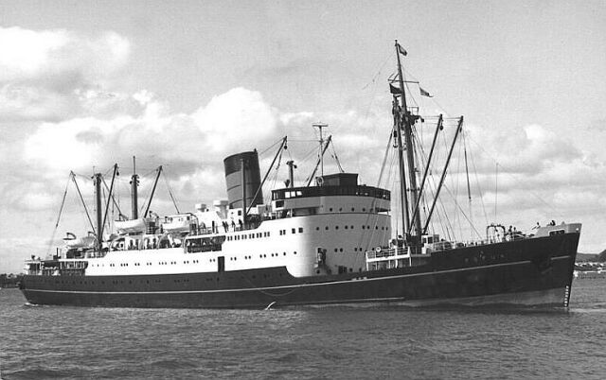
‘Necessary or convenient’ clauses
Morton v Union Steamship Co of NZ Ltd (1951) 83 CLR 402
Where legislation provides that regulations may be made prescribing matters ‘necessary or convenient’ to administering or giving effect to the Act, this means that Regs are limited to matters that will make administering Act more effective. Regs cannot go beyond the scope of the Act. Scope to be determined by ‘the character of statute and the provisions it contains’. If Act ‘lays down only main outlines of policy and indicates an intention of leaving it to the G-G to work out…policy by specific regulation…power to make regulations may have wide ambit.’ Act in this case was more specific (Reg imposed
additional excise liability).
Statutory interpretation is important here (revise Topic 2)
Decision maker (and any reviewer) must always interpret and apply the statute on which the decision was based
Principles of statutory interpretation (recall ss15AA and 15AB Acts Interpretation Act 1901 (Cth))
Presumptions – recall eg principles of legality; consistency with international obligations; beneficial construction.
Administrative Law –LAW1023

Slide 20

‘Necessary or convenient’ clauses
Shanahan v Scott (1957) 96 CLR 245
Marketing of Primary Products Act 1935-53 (Vic), s 43(1):
The Governor in Council may make regulations providing for all or any purposes necessary or expedient for the administration of the Act…
Egg and Egg Pulp Marketing Board Regulations, r 44 provided that:
No person may place any eggs in cold storage premises without the permission of the Egg and Egg Pulp Marketing Board (subject to certain exceptions for domestic use, this was an offence under the Reg).
HCA Held: Regulations cannot extend the scope of the Act, they can only be incidental to administration of it. Reg 44 purports to extend the scope of the Act, because it applies to eggs outside the scope of the Board’s authority, and goes beyond what is necessary for the purposes of the Act.
‘Supplements’ rather than ‘complements’ and is therefore ultra vires…
Administrative Law –LAW1023

Slide 21


Subordinate Legislation- purposive powers
The courts distinguish between ‘subject matter’ regulatory powers (as M57 and Foley v Padley) and ‘purposive’ powers. Eg:
SA v Tanner (1989) 166 CLR 161
Waterworks Act 1932 (SA) gave power to make regs for regulating/ controlling/ prohibiting use of land within watershed ‘so as to reduce or prevent the deterioration or pollution of any water within a watershed….’ G-G made reg prohibiting erection/enlargement of any ‘piggery, zoo or feedlot’ within watersheds. Power included prohibition and extended to prevention of pollution. HCA approved proportionality test to check that regulation was ‘reasonably proportionate/appropriate/adapted to the end to be achieved’ (taken from constitutional jurisprudence on external affairs and defence powers). NB
Brennan J again thought too broad
Administrative Law –LAW1023

Slide 22

More usually, decision making will misinterpret legislation.
Haneef case
Interpretation of character test in Migration Act 1958 (Cth)
Visa can be cancelled if there is an ‘association’ whom the Minister reasonably suspect had been involved in criminal conduct
High Court: = narrow reading . Only associations that have ‘some bearing on the persons character’
Other Examples
A statutory power to run ‘tramways’ did not authorise running
a bus service (London City Council v A-G [1902] AC 165)
A statutory power authorising customs agents to seize
‘goods, moveable property, or monies in the form of cash’
did not authorise seizure of money in a bank account
(Vickers v Minister for Business & Consumer Affairs (1982)
43 ALR 389)
ADJR Act ground in s 5(1)(d) – ‘that the decision was not authorised by the enactment in pursuance of which it was purported to be made’
Administrative Law –LAW1023

Slide 23

Acting Beyond Power – Decisions
Entick v Carrington (1765) 19 St Tr 1030
Secretary of State issued search warrant for seditious material against Entick. Entick sued for trespass and won. All govt action must be sourced in law; esp if it affects rights such as private property. Lord Camden CJ: rights preserved unless taken away ‘by some public law for the good of the whole’ – in this case no such law existed.
A v Hayden (No 2) (1984) 156 CLR 532
ASIS* officers not authorised to commit criminal offences, without express statutory exemption from prosecution. Crown in the past had ‘dispensing power’ but HCA said its danger had been recognised and it had been fully abolished by 1689 Bill of Rights (one of the plaintiff ASIS officers argued that it was not beyond executive power for a Minister to order an agent to kill someone).
ICAC v Cunneen (2015) 318 ALR 391
Cunneen’s advice to her son’s girlfriend (to fake chest pains) did not fall within the definition of corrupt conduct under the Act. Therefore ICAC had no authority to investigate.
Administrative Law –LAW1023

Slide 24
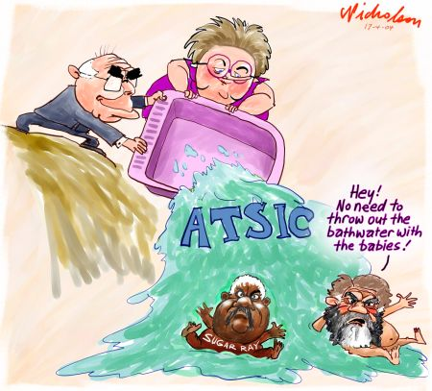


Subordinate Legislation – purposive powers
Vanstone v Clark (2005) 147 FCR 299
ATSIC Act 1989 (Cth) provided that Minister could suspend a Commissioner for ‘misbehaviour’ after making a determination under s4A. Vanstone made ATSIC (Misbehaviour) Determination 2002, specifying conduct including disruption of meetings, harassment, dishonesty, bribery, criminal conviction carrying term of imprisonment and more.
Geoff Clark, the Commissioner in question who had been convicted of obstructing police, challenged his suspension. HCA said Minister failed to take into account a relevant consideration (ie that in some jurisdictions’ offences carrying terms of imprisonment were relatively trivial eg intoxication, offensive language offences), rendering the Determination disproportionate. Might have been OK if it had specified actual behaviour.
NB lack of ‘reasonable proportionality’ potentially easier to establish than Wednesbury unreasonableness, but still a very high bar and only applies to purposive legislation.
In Australia - irrationality test
Administrative Law –LAW1023

Slide 25

Acting Beyond Power – Subordinate Legislation continued
Plaintiff M47/2012 v Director-General of Security (2012) 251 CLR 1
Plaintiff was confirmed as refugee by delegate of Minister, but refused permanent protection visa on basis of ‘Public Interest Criterion 4002’ (part of the Migration Regulations 1994) due to adverse ASIO assessment.
HCA held PIC4002 invalid because it denied merits review process under s 500 of the Migration Act 1958 (Cth) and effectively handed power to ASIO to make decision – the subordinate legislation was inconsistent with the Act.
Administrative Law –LAW1023

Slide 26

Djokovic v Minister for Immigration, Citizenship, Migrant Services and Multicultural Affairs [2022] FedCFamC2G 7
Exercise of power conferred by s 133C(3) of Migration Act (where Minister for Immigration makes decision to cancel applicant’s visa)
Are their preconditions to the exercise of discretion?
Can the minister be satisfied it is in the public interest to cancel the visa under s116 Migration Act?
Judge Kelly at [58] ministerial satisfaction respecting the matters in each limb of s 133C(3)(a) and (b) is essential to the existence of the Minister’s statutory discretionary personal power to consider cancellation….. In each case, the nature of the satisfaction of the Minister that is necessary and sufficient to engage the power in s 133C(3) “is a state of mind formed reasonably and on a correct understanding and application of the applicable law.”
Source: Wikicommons
Administrative Law –LAW1023

Slide 27
Mandatory Procedures
ADJR Act s5(1)(b): ‘that procedures that were required by law to be observed in connection with the making of the decision were not observed
Common law name: ‘disregard of essential procedural requirement’ (see eg ABC v Redmore (1989) 166 CLR 456) (tb [16.2.5])
Historically, courts distinguished between mandatory and directory rules (examples of mandatory rules include provision of copy of warrant; public notification of a development application now we use different approach from HCA case of Project Blue Sky
ADJR Act s5(1)(b): ‘that procedures that were required by law to be observed in connection with the making of the decision were not observed’ (see also s6(1)(b) re conduct)
NB some Acts spell out consequences – eg Legislative Instruments Act 2003 (Cth) says LIs are unenforceable if not registered on Federal Register.
Administrative Law –LAW1023

Slide 28


Procedural requirements
Project Bluesky (again)
Facts: Australian Broadcasting Authority (ABA) required to make
program standards re: Australian content (s.122 Broadcasting Services Act 1992 (Cth)).
s160 Act – ABA to perform functions in manner consistent with (d) Australia’s intl obligations (conventions or agreements with other countries)
ABA - content standard requiring TV networks to have Aust content of 50-55%
Project Blue Sky company (NZ) made shows including ‘Xena Warrior Princess’ (pictured): ABA’s content standard inconsistent with protocol made under a trade agreement (‘no less favourable’ treatment provision)
Q: was failure to follow s160(d) a procedural requirement, breach of which would lead to invalidity of the content standard made under s.122?
Administrative Law –LAW1023

Slide 29
Procedural Ultra Vires – Project Blue Sky - McHugh, Gummow, Kirby and Hayne J
HCA held (per McHugh, Gummow, Kirby and Hayne JJ):
‘An act done in breach of a condition regulating the exercise of a statutory power is not necessarily invalid and of no effect.’
Criticised traditional mandatory/directory distinction…
Instead, should look to parliamentary intention:
(i) Language of the statute
(ii) Subject matter and objects of statute
(iii) Consequences to the parties of a finding that actions done in breach of the condition are void
NB ‘no decisive rule’ – ‘contestable judgment’. In this case, s 160 directed to policy guidance for ABA – impossible in practice to have regard to 900+ treaties to which Australia is party – much inconvenience if many acts of ABA (eg grants of licences) were invalidated – court found no Parl. intention that breach should lead to invalidity. Still, foreign producers could sue
for breach of s 160, and effect was threat to local content.
NB Brennan CJ dissented, holding Standard invalid
Administrative Law –LAW1023

Slide 30
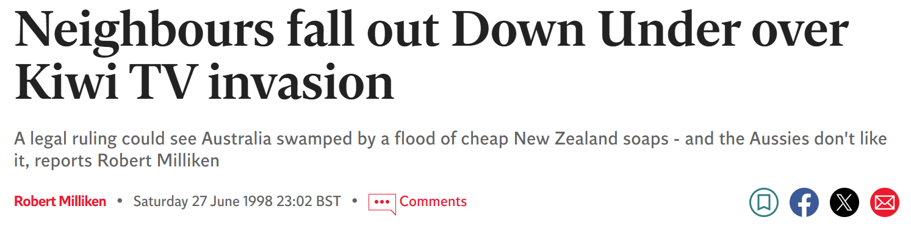

Aftermath of Project Blue Sky Decision
Letter from Australian actors to John Howard: http://www.independent.co.uk/news/neighbours-fall-out-down-under-over-kiwi-tv-invasion-1168190.html
Parliament Inquiry – Government responded by limiting application of PBS ruling to NZ only
This is still the case: See Australian Content Standard: https://www.legislation.gov.au/Details/F2016L00392
…which recognises NZ programs in s 5(3):
‘While Australian culture and New Zealand culture are different from each other, in order to be consistent with the Protocol on Trade in Services to the Australia New Zealand Closer Economic Relations Trade Agreement, this standard recognises New Zealand programs and Australia/New Zealand programs equally with Australian programs for the purposes of compliance with this standard’.
Administrative Law –LAW1023

Slide 31
Application of PBS Decision – Migration Cases
SAAP v Minister Immigration (2005) HCA 24
  Section 424A Migration Act – information used to reach decision must be provided to applicant in writing
  Refugee Review Tribunal – gave oral comment rather than written comment on evidence used
  HCA held – breach of s 424A, given importance of s 424A obligation in scheme of Act this constitutes an invalid decision (see eg Hayne J – mandatory language used by Parliament, ‘must’, plus context)
Minister Immigration v SZIZO (2009) HCA 37
  Section 441G Migration Act – authorised recipient to receive docs
  HCA held: Here failure to notify authorised recipient did not lead to unfairness or denial of natural justice as the applicant attended hearing and make submissions after; decision still valid. The notification was not important in itself but only to ensure that these things took place.
Administrative Law –LAW1023

Slide 32

Power Exercised by Wrong Person (Improper Delegation)
ADJR Act s5/6(1)(c) – person did not have jurisdiction or (d) – not authorised by statute
Delegation - decision-maker (principal) passes authority to decide to another person (usually someone junior). Only applies in practice to decisions (not regulations).
Common law presumption against delegation of power and the sub delegation of power, but can be, and often is, varied by statute or by implication.
Note three distinct categories:
(i) express power to delegate;
(ii) implied delegation; and
(iii) agency/alter ego principle
Ground at common law: ultra vires (acting beyond power)
ADJR Act provision: ss 5(1)(c) and 6(1)(c) – person did not have jurisdiction or (d) – not authorised by statute
Administrative Law –LAW1023

Slide 33

Improper Delegation- express power
Express power to delegate
Note relevant provisions of Acts Interpretation Act 1901 (Cth):
s34AA – power to delegate function allows you to delegate to a named person or to an office or position
s34AB: power to delegate does not include a power to delegate that power of delegation; principal retains power even after delegation
s34A: if an exercise of power depends on forming an opinion, and that power is delegated, the power is exercised on the basis of the delegate’s opinion Taxation
Example: Administration Act 1953 (Cth), s 8: ‘The Commissioner of Taxation may…by writing under his hand, delegate to a Deputy Commissioner…all or any of his functions under this Act…other than this power of delegation’
Courts have recognised that where there are thousands or even of millions of notices to issue or actions to take, this may favour an interpretation that the power was envisaged to be delegated
Administrative Law –LAW1023

Slide 34
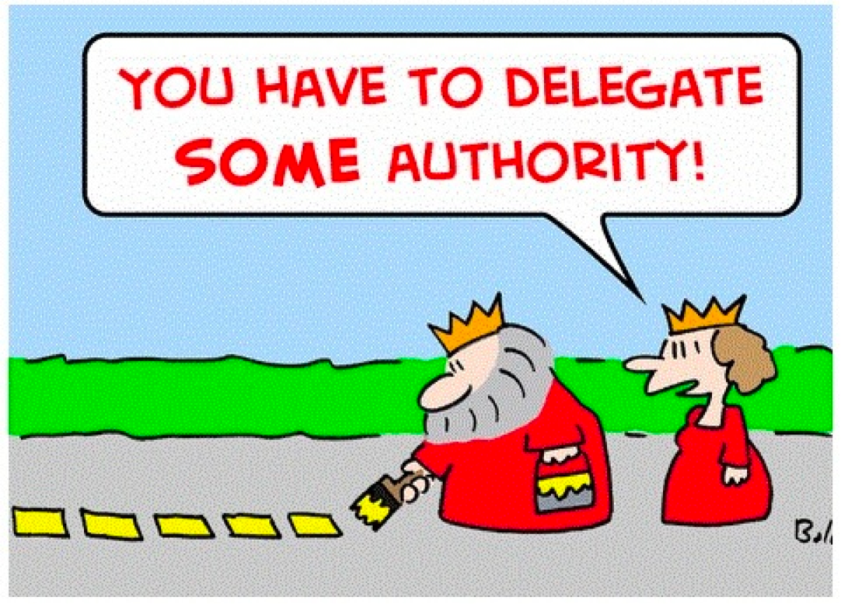
Improper Delegation- implied power
Courts may imply into the statute a power to delegate if circumstances dictate need.
This usually turns on the words, structure or subject matter of the statute. See eg Ex parte Forster, Re Uni of Sydney [1963] SR 723
Re general rule against sub- or further delegation – the construction of the statute must be considered with:
  ‘due regard to the purpose and objects of the statute, the character of the power which is conferred, the exigencies of the occasions which may arise with respect to its exercise and other relevant considerations’
In this case the University Senate (like Council) authorised faculties to terminate enrolment of students who had failed twice – held to be allowed (ie Senate was allowed to delegate statutory powers to faculty committee; the ‘initial delegation’ being from the legislature to the Senate).
Administrative Law –LAW1023

Slide 35

Improper Delegation – agency/alter ego
Agency/alter ego principle
Common law recognises that in certain cases, agents can act in name of principal
Difference between delegation and agency:
Delegation: person (delegate) acts in their own name (see Re Reference under s 11 Ombudsman Act for example of delegate failing to act (sign) in own name as required by statute;
Agency/alter ego principle: junior person acts in name of the superior (eg ‘Mary Jones, on behalf of the Minister’ – see eg O’Reilly case discussed below)
Administrative Law –LAW1023

Slide 36

Improper Delegation – agency/alter ego
Carltona v Commissioners of Works [1943] 2 All ER 560
Facts: Carltona owned fruit-packaging factory.
World War II - Minister of Works took over the factory in the national interest
Defence (General) Regulations 1939 - ‘competent authority’ (included Commissioner of Works and Planning Minister) could requisition land in national interest
Letter to Carltona: signed by ‘Mr Morse on behalf of the Minister’ (officer in Planning Dept)
Carltona argued this decision was UV - Morse not ‘competent authority’ under the statute
Administrative Law –LAW1023

Slide 37

Agency/alter ego – Carltona case
UK Court of Appeal:
Introduced ‘alter ego principle’ – act was not under delegation but ‘in the name of’ the Minister
Ministers: special position of constitutional responsibility; ‘multifarious and complex tasks’
Administrative necessity to have some work done by agents – Parliament must have intended such
On facts: thousands of war requisitions made
Considerations included: Ministerial responsibility to Parliament remains (at least in theory); ever-growing complexity and size of modern government makes any other result unworkable
Administrative Law –LAW1023

Slide 38

Agency/alter ego – O’Reilly Case
O’Reilly v State Bank of Victoria (1982) 153 CLR 1
Facts: Commissioner of Taxation: expressly and validly delegated certain functions to Deputy Commissioner of Taxation (Taxation Administration Act)
Notices sent by Chief Investigative Officer (K. Holland); not personally signed by the Deputy Commissioner (had ‘facsimile’ of his signature’)
H – acting under authorisation of Deputy Commissioner
Taxpayers argued notices were invalid (breached rule against sub-delegation). Deputy Commissioner responded that he had applied the Carltona principle.
Administrative Law –LAW1023

Slide 39
Agency/alter ego – O’Reilly Case
High Court
Delegation versus agency (cited Carltona)
Carltona principle - ‘equally persuasive . . to the head of any large govt department’ (such as Deputy Commissioner of Taxation, who typically oversees whole branch office in state or territory)
Commissioners, like Ministers, are given functions so ‘multifarious’ that they could not personally attend to them all. Practical administrative necessity may require a decision maker to act via an agent despite the existence of an express power to delegate.
NB Mason J dissent – should have delegated properly, because it was significant power over people’s rights.
Administrative Law –LAW1023

Slide 40

Agency/alter ego – Northern Land Council v Quall - [2019] FCAFC 77
Full Federal Court
Delegation versus agency (again cited Carltona – see para 54)
Question was whether the NLC (created under the Native Title Act 1993 (Cth)) could delegate its power to certify Indigenous Land Use Agreements (NNTT explainer)
Considering the importance of the NLC’s duty to promote and protect the interests of the Indigenous communities it represents, Court said this power should not be delegable.
s203BK of Native Title Act has ‘necessary and convenient’ clause – Court carefully examined purposes and context of Act, applied Shanahan, and concluded that the section allowed the NLC to come to certain mutual arrangements with others, but not to delegate its powers unilaterally – ie ‘outsource’ one of its key functions (see para 136).
Administrative Law –LAW1023

Slide 41
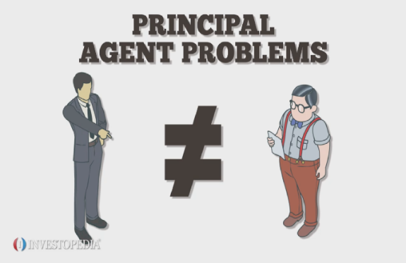
Questions re Delegation and Agency
If someone is a delegate, can they also be an agent?
Re Reference under Ombudsman Act s11 (1979) 2 ALD 86
Can a delegate appoint an agent?
O’Reilly v State Bank of Victoria (1983) 153 CLR 1
Can an agent appoint an agent?
Pattenden v Commissioner of Taxation (2008) 175 FCR 1
Administrative Law –LAW1023

Slide 42
Questions re Delegation and Agency
Delegation
  Power to delegate or sub-delegate must be express or implied in statute
  Delegate acts and signs in own name
  Delegate must exercise their own discretion/power; and
  Delegator retains power (ie both delegator and delegate have power). Therefore, you can appeal decision to delegator.
Agency
  Can appoint an agent where there is practical administrative necessity to do so
  Agent acts and signs in the name of the principal (extension of the principal);
  Agent exercises the principle’s discretion/power; and
  Principal's power is spent once agency exercises it.
Administrative Law –LAW1023

Slide 43


Exam Hint
Identifying whether the person who is exercising the authority is an agent or a delegate ( and hence whether the exercise of power is valid) is a common exam question.
Administrative Law –LAW1023

Slide 44
—
Questions?
Email
richard.taylor2@rmit.edu.au

